Slide 1
South Lakes HS Back to Band
August 21, 2019

Slide 2
Our South Lakes Bands
SLHS Band Ensembles
Concert Band
Marching Ensembles
Marching Band
Winter Guard
Wind Ensemble
Symphonic Band
Jazz Band (after school only)

Slide 3
Class Structure
Period 1
Wind Ensemble
Winds only
Advanced band credit
Period 3
Symphonic Band Green
Winds only
Intermediate band credit
Period 5
Percussion
Percussion only
Will be split between Wind Ensemble, Symphonic Band, and Percussion Ensemble
All students in marching band
Students do not march
All students in marching band
Period 6
Symphonic Band Blue
Period 10
Jazz Band
Winds only
Advanced band credit
All students in marching band
Afterschool class November to May 3:15 - 4:45
All students in marching band

Slide 4
Our Vision for the Program
Vision Statement To be widely recognized as a high school band that nurtures a diverse community of students who will become valued members of society Mission Statement To provide a music education experience for band students that fosters self-respect, pride and social responsibility
Strategic Goals Build a culture of excellence and Esprit de Corps Nurture band student and leadership development Develop strong community partnerships Create a sustainable recruiting and retention system Secure sustainable funding | Core Values Encouragement Perseverance Excellence Respect Honor/Integrity

Slide 5
The Charms System
FCPS adopted Charms Office Assistant for all HS band programs
Used to send emails and track critical band information
Students and their families can view the band calendar and keep their information up to date
Refer to the South Lakes Band Charms Tip Sheet in band packet
Access Charms regularly, and keep your information current!
Email addresses
Cell phone # & carrier
Dietary restrictions

Slide 6
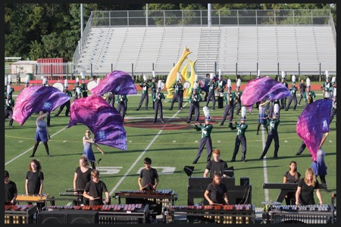
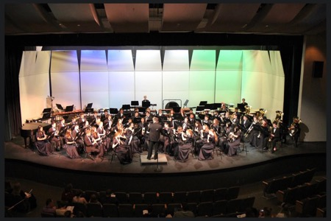
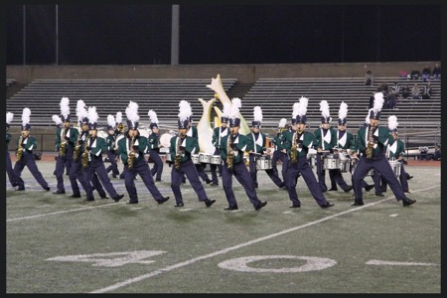
Performances
This year’s performances include:
5 home football games
5 concerts
4 marching & 2 concert assessments
2 pyramid outreach events
2 parades
Charms calendar includes schedule of all performances

Slide 7
Performances – more details
A performance is a unit test assessment grade.
Band SOL’s
VBODA Assessment Oct 19 at Rock Ridge
VBODA Assessment March 20-21
Important Dates
National Concert Band Festival Indianapolis March 12-15
VMBC Dates 9-28, 10-12, 11-2

Slide 8
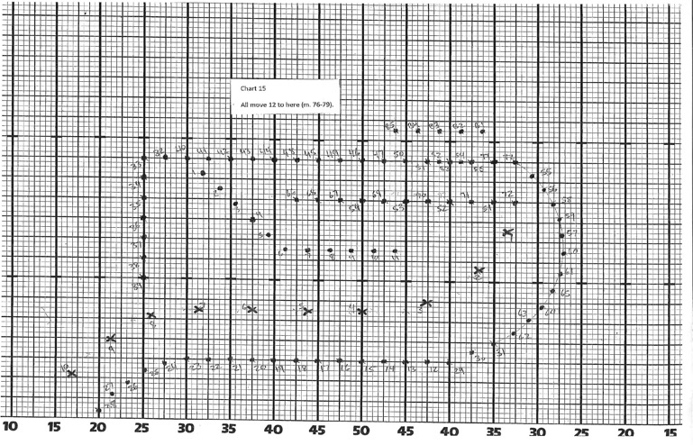
Rehearsals
The full band meets ONLY during after school and evening rehearsals
Ensemble performance depends on every student and students depend on each other
See Charms for the rehearsal schedule

Slide 9
Typical Rehearsal Schedule – Charms has actual schedule, as rehearsal space impacts rehearsal times
Marching Band August through November
Mondays 3:15 – 5:45
Symphonic Band November through June
Thursdays 3:15 - 4:45
Wind Ensemble November through June
Nov – Dec: Wednesdays 3:15 – 5:00
Jan – June: Wednesdays 6:00-9:00
Wednesdays 6:00 – 9:00
Thursdays 3:15 – 6:00
Jazz Band January through June
Tuesdays 3:15 - 5:00
School Events, Holidays and Religious events will dictate schedule so please use charms to keep up with most current schedule

Slide 10
Concert Uniforms
Concert Band Uniforms are a graded part of assessment. See Mr. Fore if assistance is needed
Concert dresses are ordered through the school – measurements will be taken during the second week of school.
Tuxedos are purchased by families and include:
Black jacket
black bow tie
tuxedo shirt
black pants
black socks that extend above the ankle
black dress shoes

Slide 11
Upcoming Trips
2019-20 Wind Ensemble
National Concert Band Festival
March 12-15, 2020
Indianapolis, IN
2019-20 Full Band
Exploring a short trip to Williamsburg, VA or VA Beach for Spring 2020
Details will be released in September 2019
2022-21 Spring Trip (full band) will be Orlando, Florida!

Slide 12
Band Booster Leadership
President – Andrea Mravlja
VP Fundraising – Michelle Creemer
VP Policy & Programs – Melissa Gifford
Treasurer – Nikki Matthews
Communications Directors – Julia Hickey/Melanie Erler
Secretary - Jade Horne
Performance Chair –Joe Crowley
Finance Chair – Kristine Kosowiec
Pyramid Chair – Gretchen Hazlin – new!
Guard Liaison – Nancy Shah – new!
Notes:
Welcome new families
Fortunate to have active band booster community
Mr Fore & kids do heavy lifting, but we make it easier, fun, etc.
Great way to stay connected
Introduce board – mention Pyramid opening
Introduce committee chairs – mention need for co-chairs
Rely on people stepping forward each year
Thank Erin, Ericka & Sumi
Board meeting schedule

Slide 13
Committee & Task Leadership
Uniforms – Christina Blocksom
Spirit Wear –Melanie Erler
Hospitality/Refreshments – Helen Sui & Jeri Lyn Wilson
Photography - Melissa Gifford
Citrus Sale - Jade Horne & Kristen Burke
Tag Day – Shannen & John Setlik
Battle of the Bands - Mindy Levy
Jazz Dessert – Tiffany & Clinton Diehl – new!
Programs - Cynthia Cook
Spring Trip Planning Assistance – vacant
Election Day Bake Sale – Brandi Watt

Slide 14
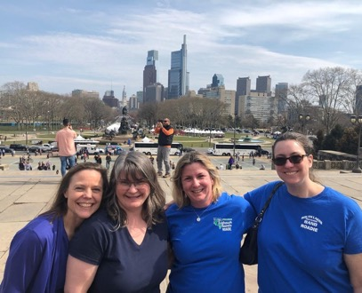
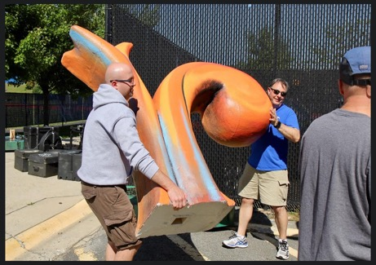
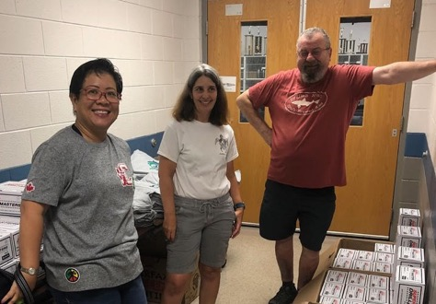
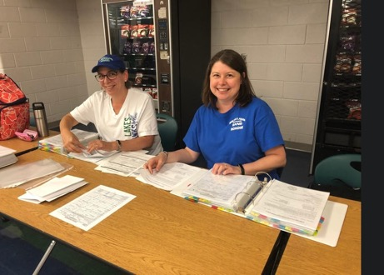
SLHS Band Boosters
Advocates • Fundraisers • Volunteers • Fans
Notes:
Fans:
Showing up and showing our support
Advocates:
Inform & involve SLHS administration, School Board, local politicians, etc.
Publicize band activities/accomplishments
Engage with other booster organizations
Support FCPS initiatives that impact the arts in our schools
Support organizations such as VBODA

Slide 15
Fundraising
Goal – fill the financial gap & provide resources/opportunities
Realize maximum profit with minimum effort/burden
Lower the cost to families
Planned activities
Tag Day
Annual Citrus Sale
Community – Jazz Dessert Concert, Election Day Baked Goods
“Passive” activities – Rebate Programs, Restaurant Nights
Areas of emphasis
Corporate matching & volunteer donor programs
Sponsorships
Notes:
Sources of funding – allocation, discretionary, fees, booster
Booster funding pays for – supplemental instruction, instruments, uniforms, etc. – budget on Charms
Bullets
Mention rebate handout
Need their help with areas of emphasis

Slide 16
Volunteering
Something for everyone, and everyone is needed!
Share your time or talent
Leverage a connection
Upcoming events
Football game – Friday, 9/6 – tailgate, field crew, stand support
Tag Day – Saturday, 9/7 – especially drivers!
What kind of help is needed and when?
Leadership positions, organizing, and odd jobs
Weekly email includes SUG
Band app!
Charms calendar

Slide 17
Before you Leave
Tables will be available until 8:15
Finance - ask questions, pay balances
Spirit Wear - order your band gear!
Forms - ask questions, turn in forms
Notary Public - get that OTC form notarized!
Tag Day - ask questions and sign up to be a driver
Q&A - grab handouts, ask questions about band
Notes:
Spirit wear! Deadline! Minimums!

